Slide 1


PY-EXPO
2K24
Team ID: T096
Team Name: THE ERROR MAKERS
Genius innovation leaves behind a legacy...
PYEXPO 2K24

Slide 2
PS Code: PY79
Problem Statement:
AQUAPONIC INDOOR FARMING ASSISTANT.
Explanation:
Aquaponics is a cooperation between plants and fish and the term originates from the two words aquaculture(the growing of plants in a closed environment) and hydroponics(the growing of plants in a soil-less environment)
02
PYEXPO 2K24

Slide 3
Solution

Aiding Aquaponics and Hydroponic bed by setting up sensors like:
Temperature
Water quality
Nutrient

Creating a software stream that remotely maintain the healthy environment of the water
Technology Stack
Technology Stack Used : Python, Django, Visual Studio
Hardware : ESP 8266, Temperature Sensor, Water level sensor
03
PYEXPO 2K24

Slide 4
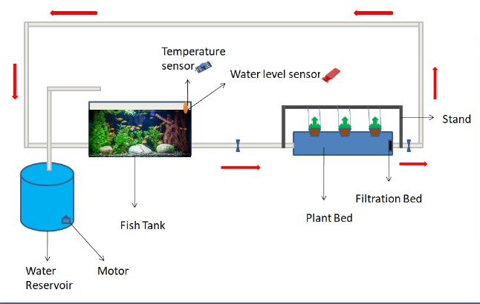
DIAGRAM :
04
PYEXPO 2K24

Slide 5
METHODOLOGY:
The wastes released from the fish is converted into nitrate that is used to grow plants by circulating the water through pipe to hydroponics bed .
The water from the plant bed is again goes to the fish tank . The fish waste and the plant waste are filtered by filter net.
Water level and temperature sensor are connected in fish tank by the help of microcontroller .
A remote system is created to intimate the user about water quality .
05
PYEXPO 2K24

Slide 6
Team Member Details:
SYED ALI FATHIMA A - 23ECB50
VIDUNASRI R - 23ECB57
THANGAMALAR M - 23ECB52
NICHOLAS MARYARCHANA A - 23ECB08
06
PYEXPO 2K24

Slide 7

Thank You
Any Queries?
PYEXPO 2K24

